Slide 1



Slide 2


Slide 3
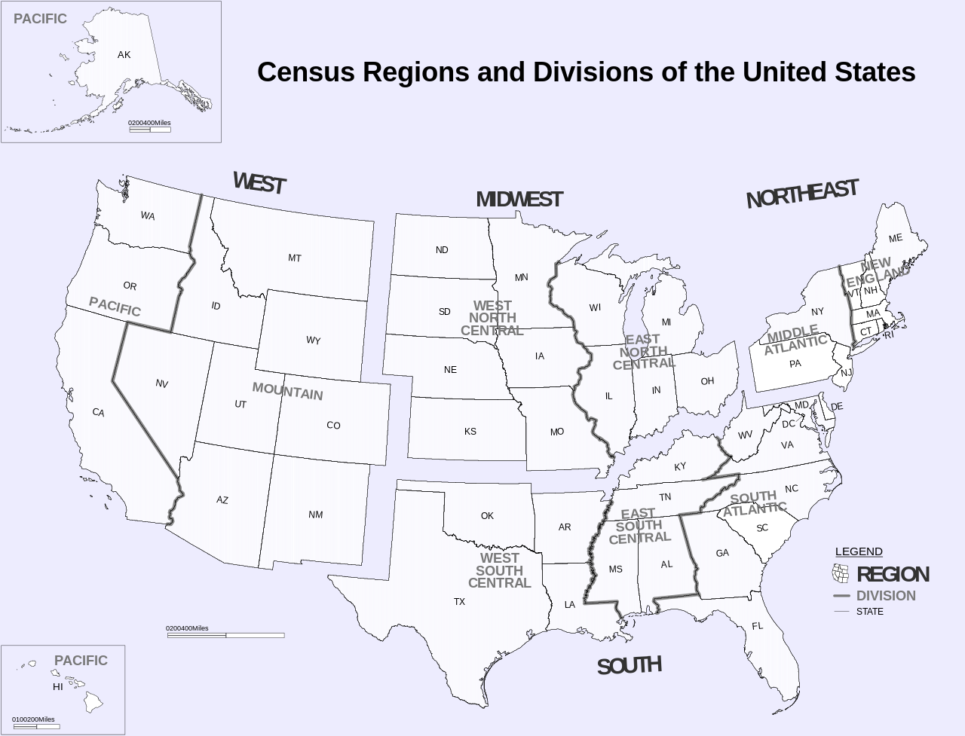
State Code | State Name
IA | Iowa
IL | Illinois
IN | Indiana
KS | Kansas
MI | Michigan
MN | Minnesota
MO | Missouri
ND | North Dakota
NE | Nebraska
OH | Ohio
SD | South Dakota
WI | Wisconsin
State Code | State Name
CT | Connecticut
MA | Massachusetts
ME | Maine
NH | New Hampshire
NJ | New Jersey
NY | New York
PA | Pennsylvania
RI | Rhode Island
VT | Vermont
State Code | State Name
AL | Alabama
AR | Arkansas
DC | Washington, D.C.
DE | Delaware
FL | Florida
GA | Georgia
KY | Kentucky
LA | Louisiana
MD | Maryland
MS | Mississippi
NC | North Carolina
OK | Oklahoma
SC | South Carolina
TN | Tennessee
TX | Texas
VA | Virginia
WV | West Virginia
State Code | State Name
AK | Alaska
AZ | Arizona
CA | California
CO | Colorado
HI | Hawaii
ID | Idaho
MT | Montana
NM | New Mexico
NV | Nevada
OR | Oregon
UT | Utah
WA | Washington
WY | Wyoming

Slide 4
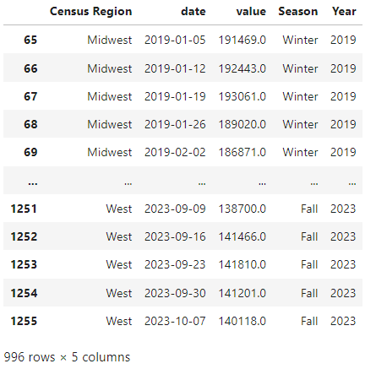
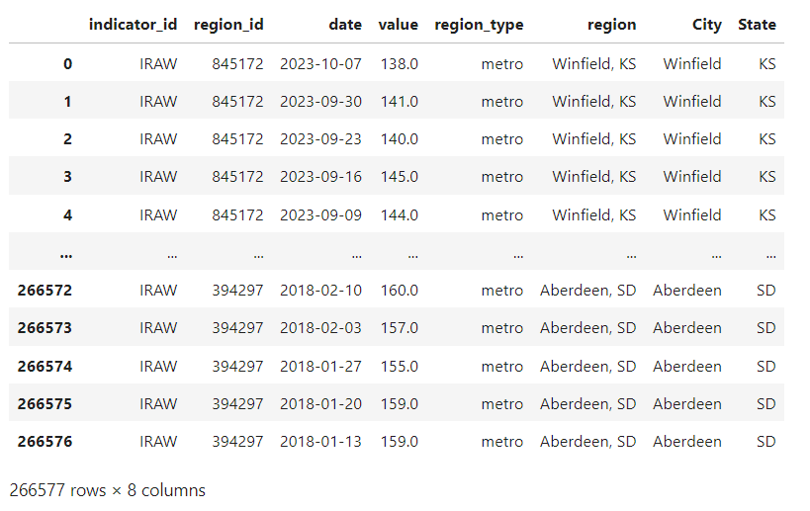
IRAW Dataset (Raw, All Metro Homes, Weekly)

Slide 5
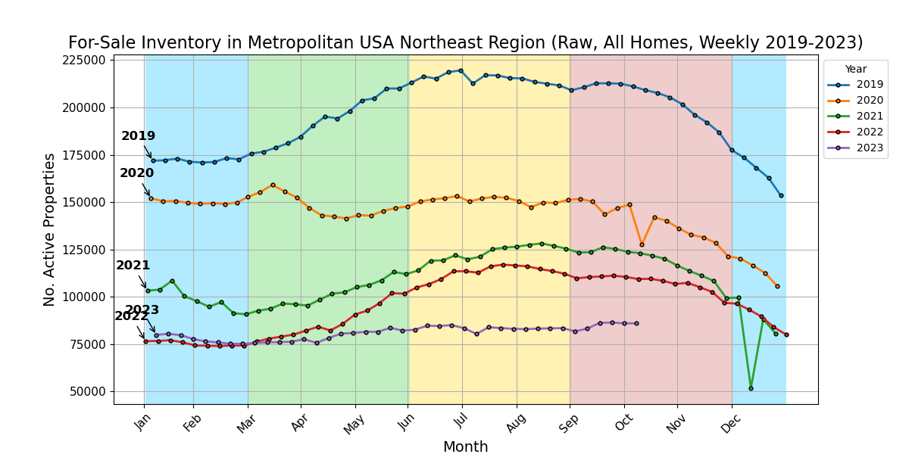

Slide 6
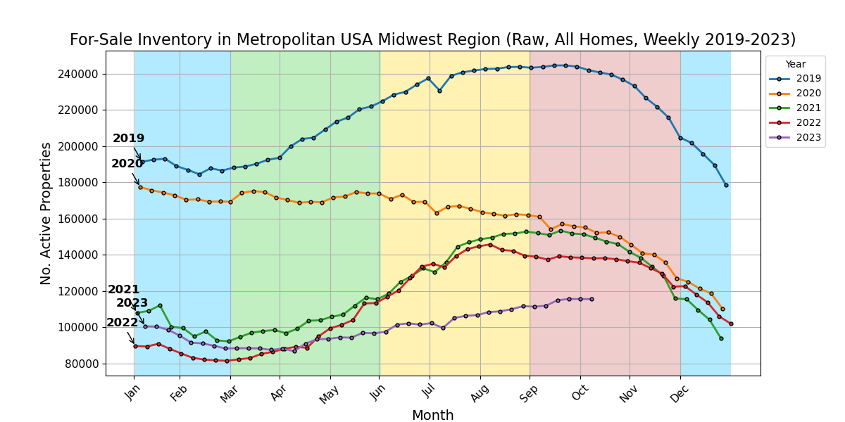

Slide 7
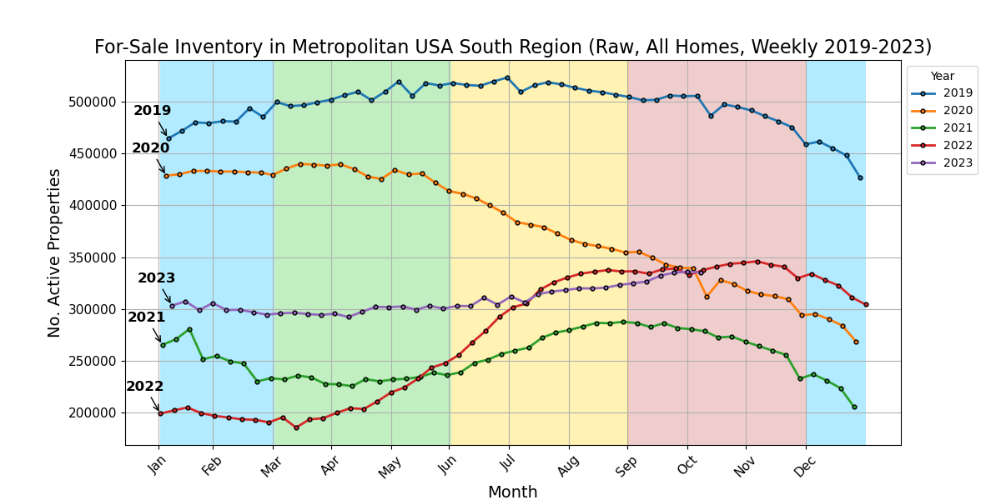

Slide 8
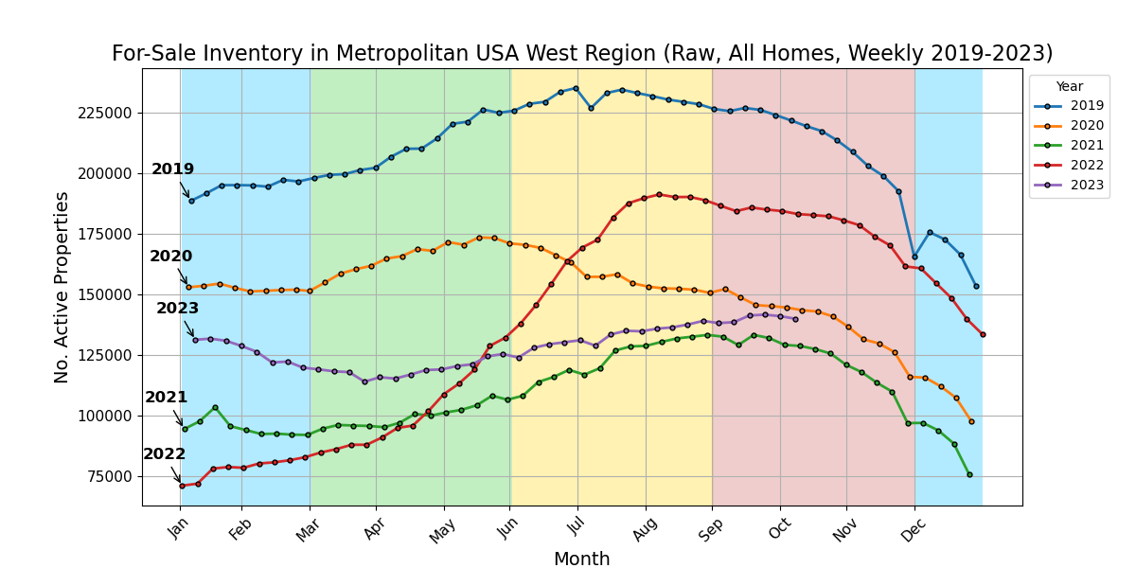

Slide 9
ANOVA Test Results
p-value = 0.008943123143410924
[ REJECT Null Hypothesis (H0) ]
p-value = 0.0006887615533247862 [ REJECT Null Hypothesis (H0) ]
p-value = 6.692988590780285e-06 [ REJECT Null Hypothesis (H0) ]
α = 0.05

Slide 10
ANOVA Test Results
p-value = 0.2543987237874858
[ FAILED TO REJECT Null Hypothesis (H0) ]
α = 0.05

Slide 11
References:
[Nasdaq Data Link API] Zillow Real Estate Data
https://data.nasdaq.com/databases/ZILLOW/documentation
United States Census Regions
https://www2.census.gov/geo/pdfs/maps-data/maps/reference/us_regdiv.pdf
Seasons: Meteorological and Astronomical
https://www.timeanddate.com/calendar/aboutseasons.html

